Slide 1
Elastic Net Regression
Scott Nelson

Slide 2
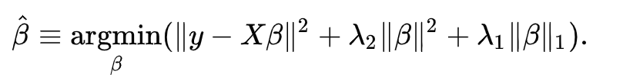
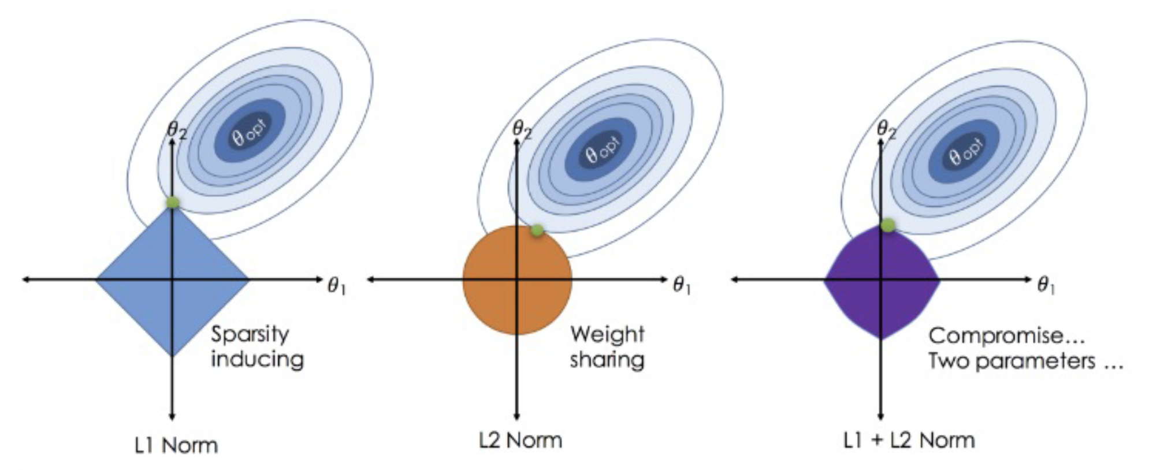
What is Elastic Net Regression
Combination of Ridge and Lasso Regression (a middle ground between both)

Slide 3
Why use Elastic Net
Handles multicollinearity very well, creating sparsity in coefficient and stabilizing coefficients
More flexible than Ridge and Lasso
Maintains the advantages of Ridge and Lasso Regression
Penalty terms for highly correlated features (Ridge)
Feature Selection (Lasso)
Fix penalties of Ridge and Lasso
Handles high dimensional data with few examples far better than Lasso
Handles feature selection of important features far better than Ridge
Main Con: More Hyper Parameters

Slide 4
Dataset

Slide 5

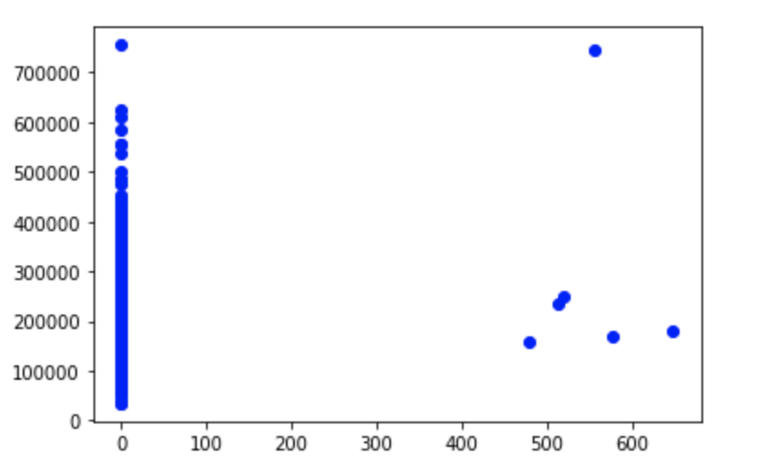
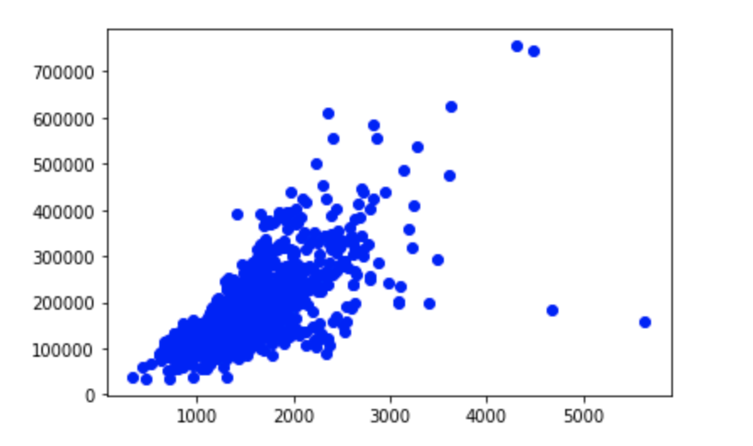
Dataset: Housing Data
Housing Data from Kaggle Competition
Started with 36 numeric features
17 Categorical Features useless to model (yearbuilt, yeargaragebuilt, etc)
19 Numerical Features used to predict Sales Price
Best features: Garage, 1st Floor Square Footage
Worst Features: Pool Area, Poarch Area
Pool Area:
General Living Area:

Slide 6
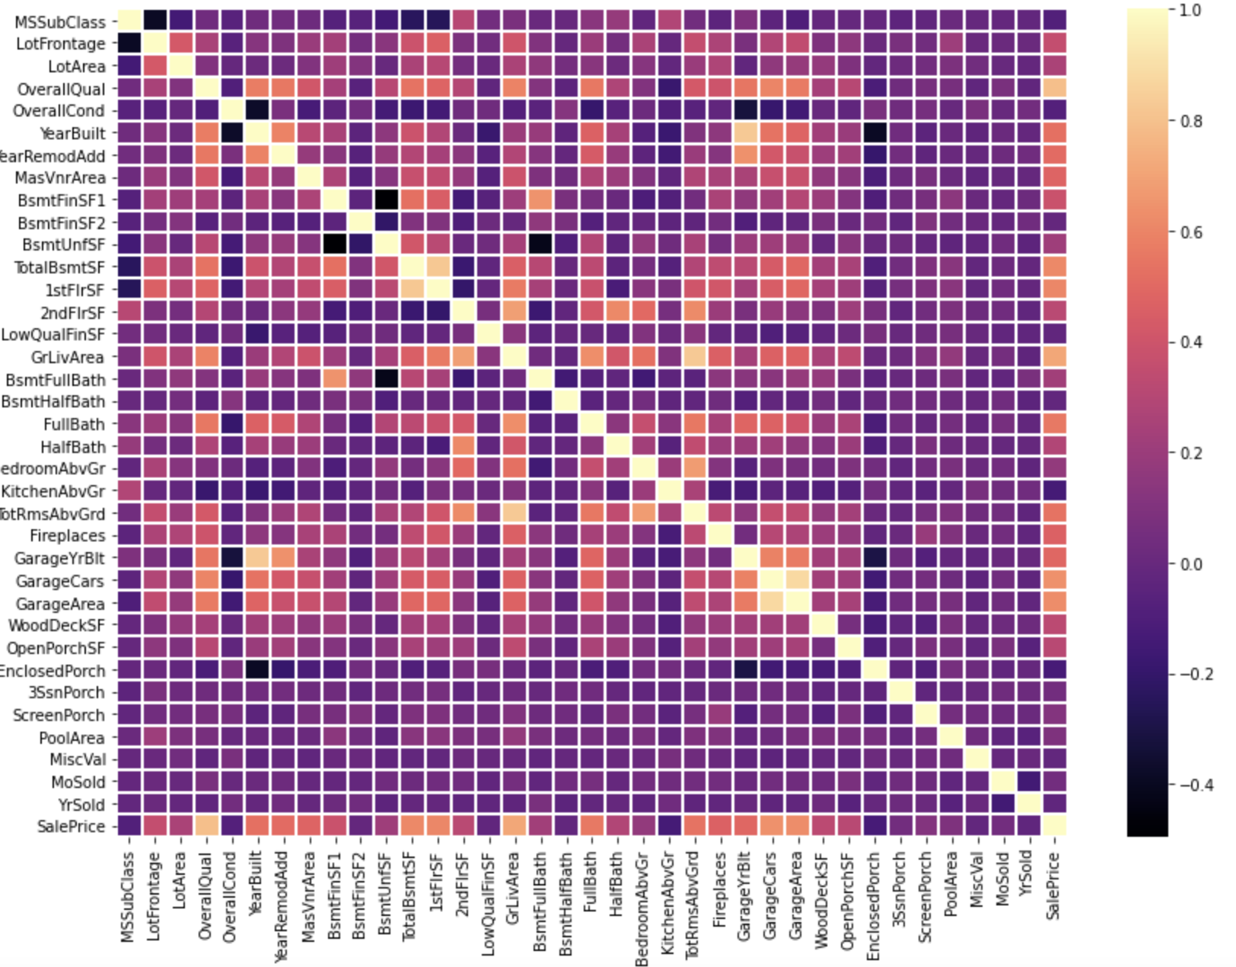
Dataset Correlation Matrix

Slide 7
Model Implementation

Slide 8
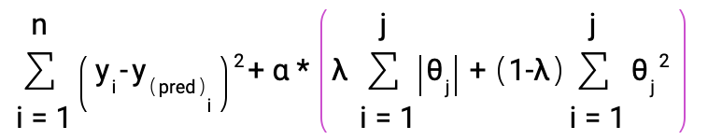
Elastic Net Implementation
Alpha: Weight controlling implementation of Ridge and Lasso terms
Mixing Parameter(λ): Ratio between Ridge and Lasso (1 = Lasso, 0 = Ridge)
Lambda_1 (Lasso): λ
Lambda_2 (Ridge): (1-λ)
Used same form as Sklearn to test numpy implementation against Sklearn’s implementation

Slide 9
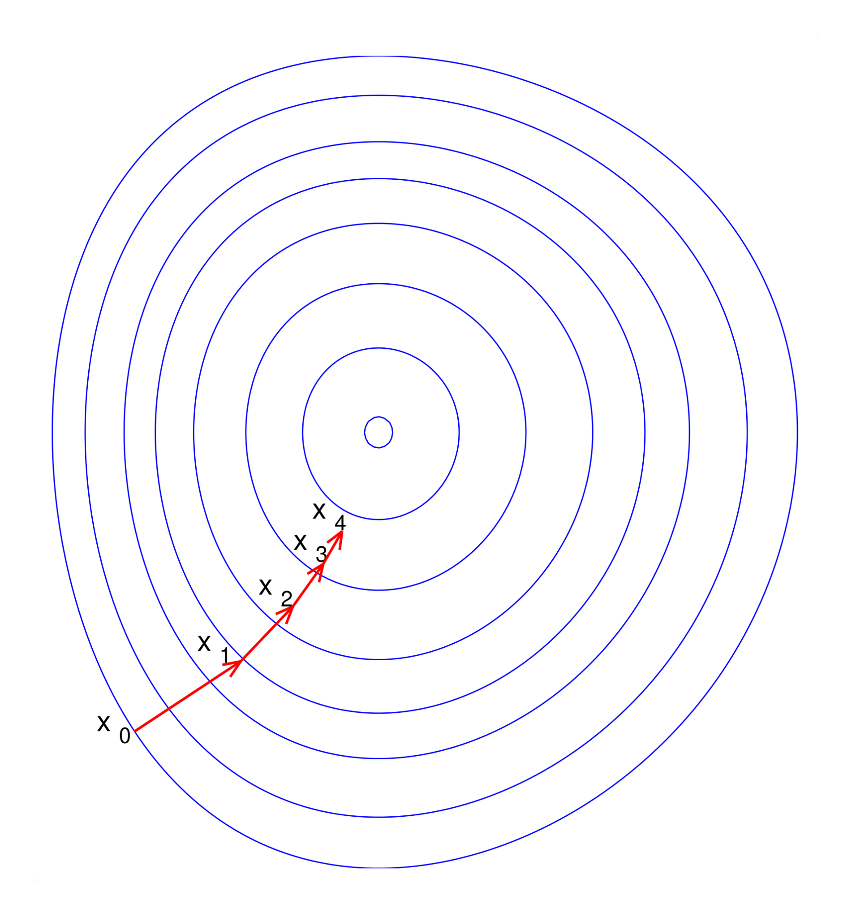
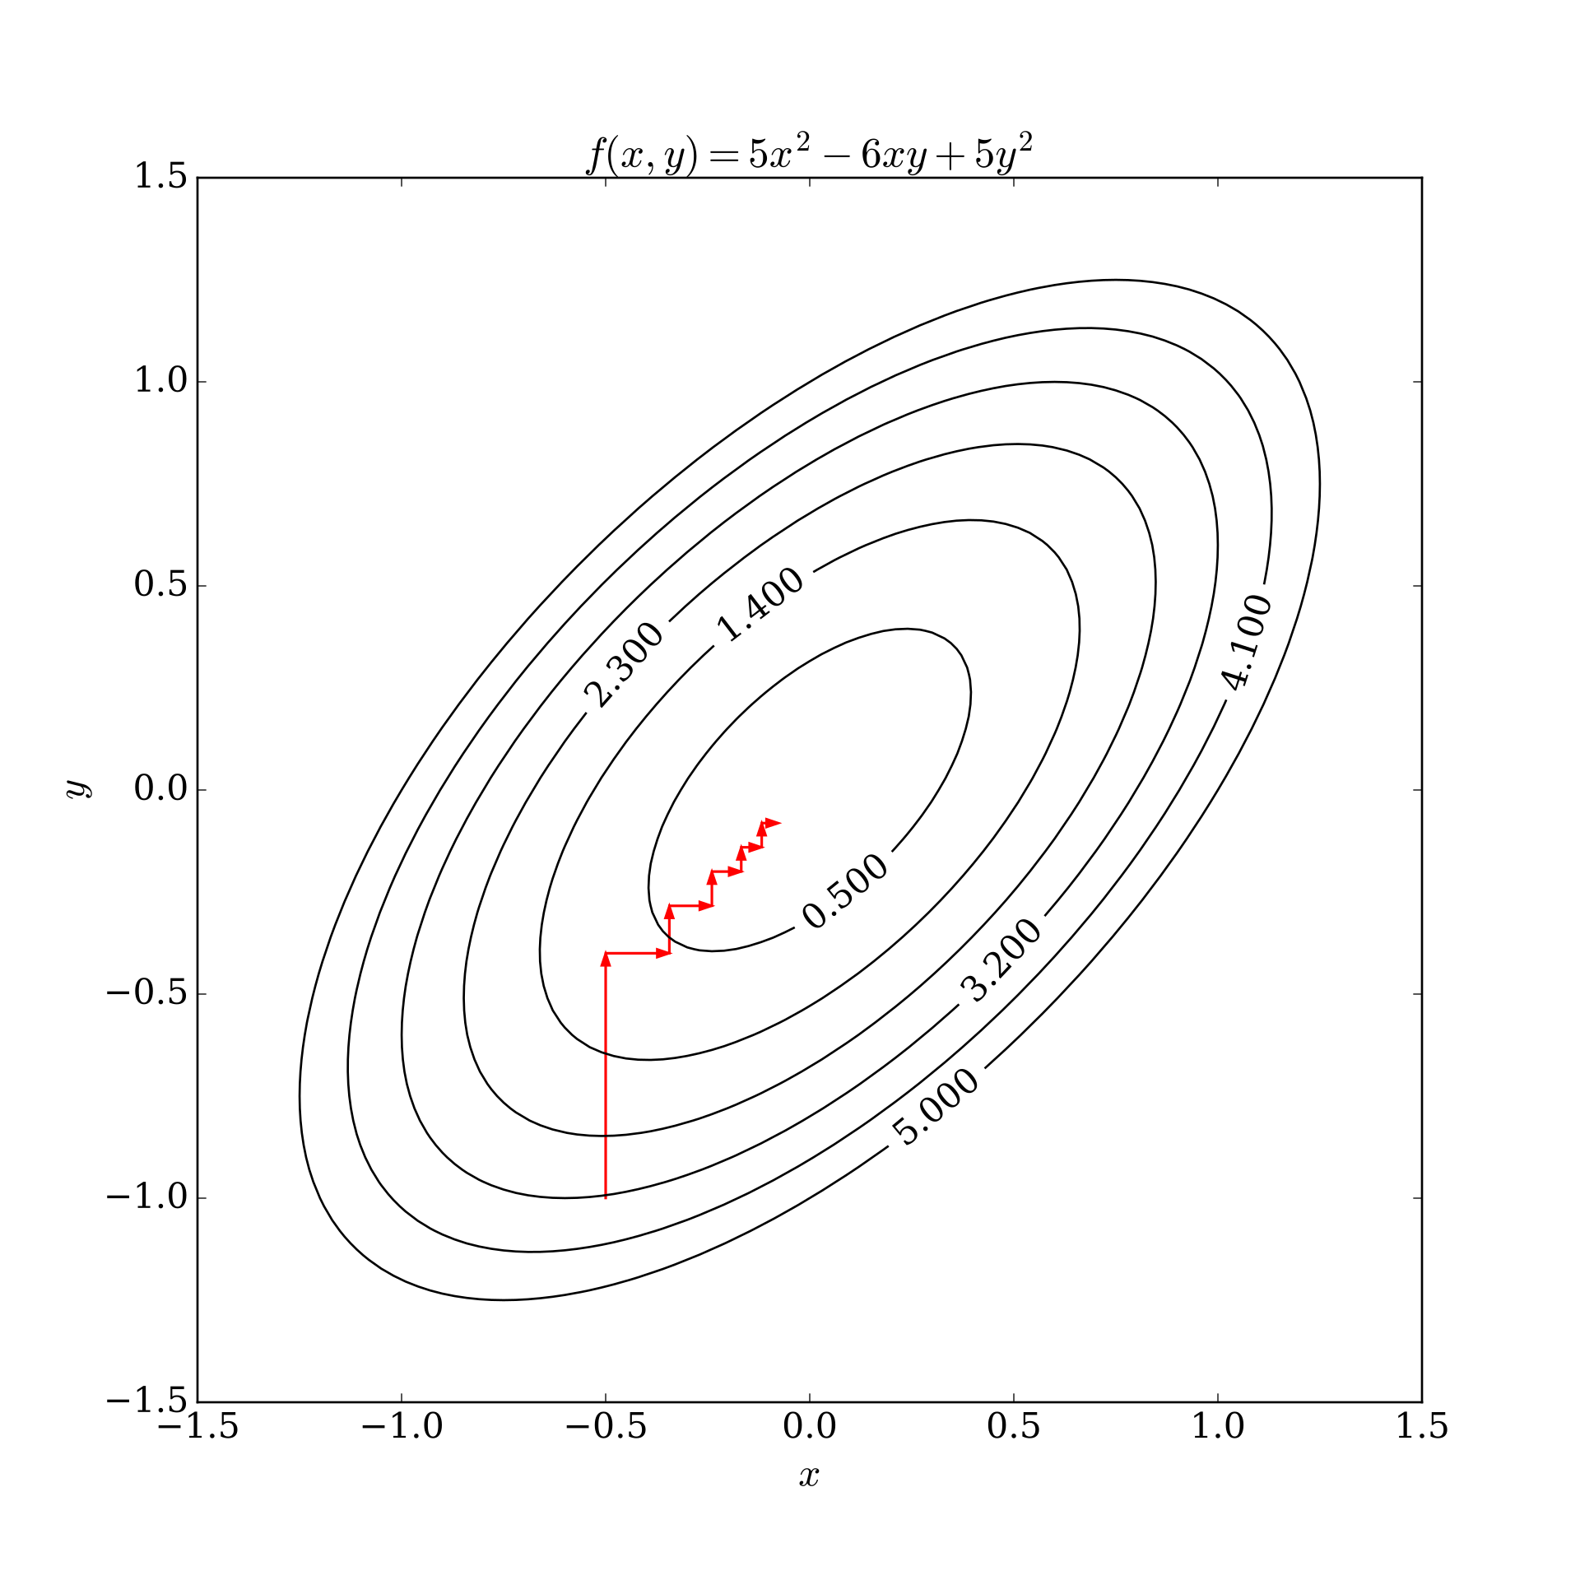
Optimization Technique
Gradient Descent:
Gradient Descent
Used as discussed in class
MSE term, L1 term, and L2 Term
Faster convergence
Coordinate Descent
Loop through features and tune each parameter
Less computationally intense
Took significantly longer than gradient descent
Coordinate Descent:

Slide 10
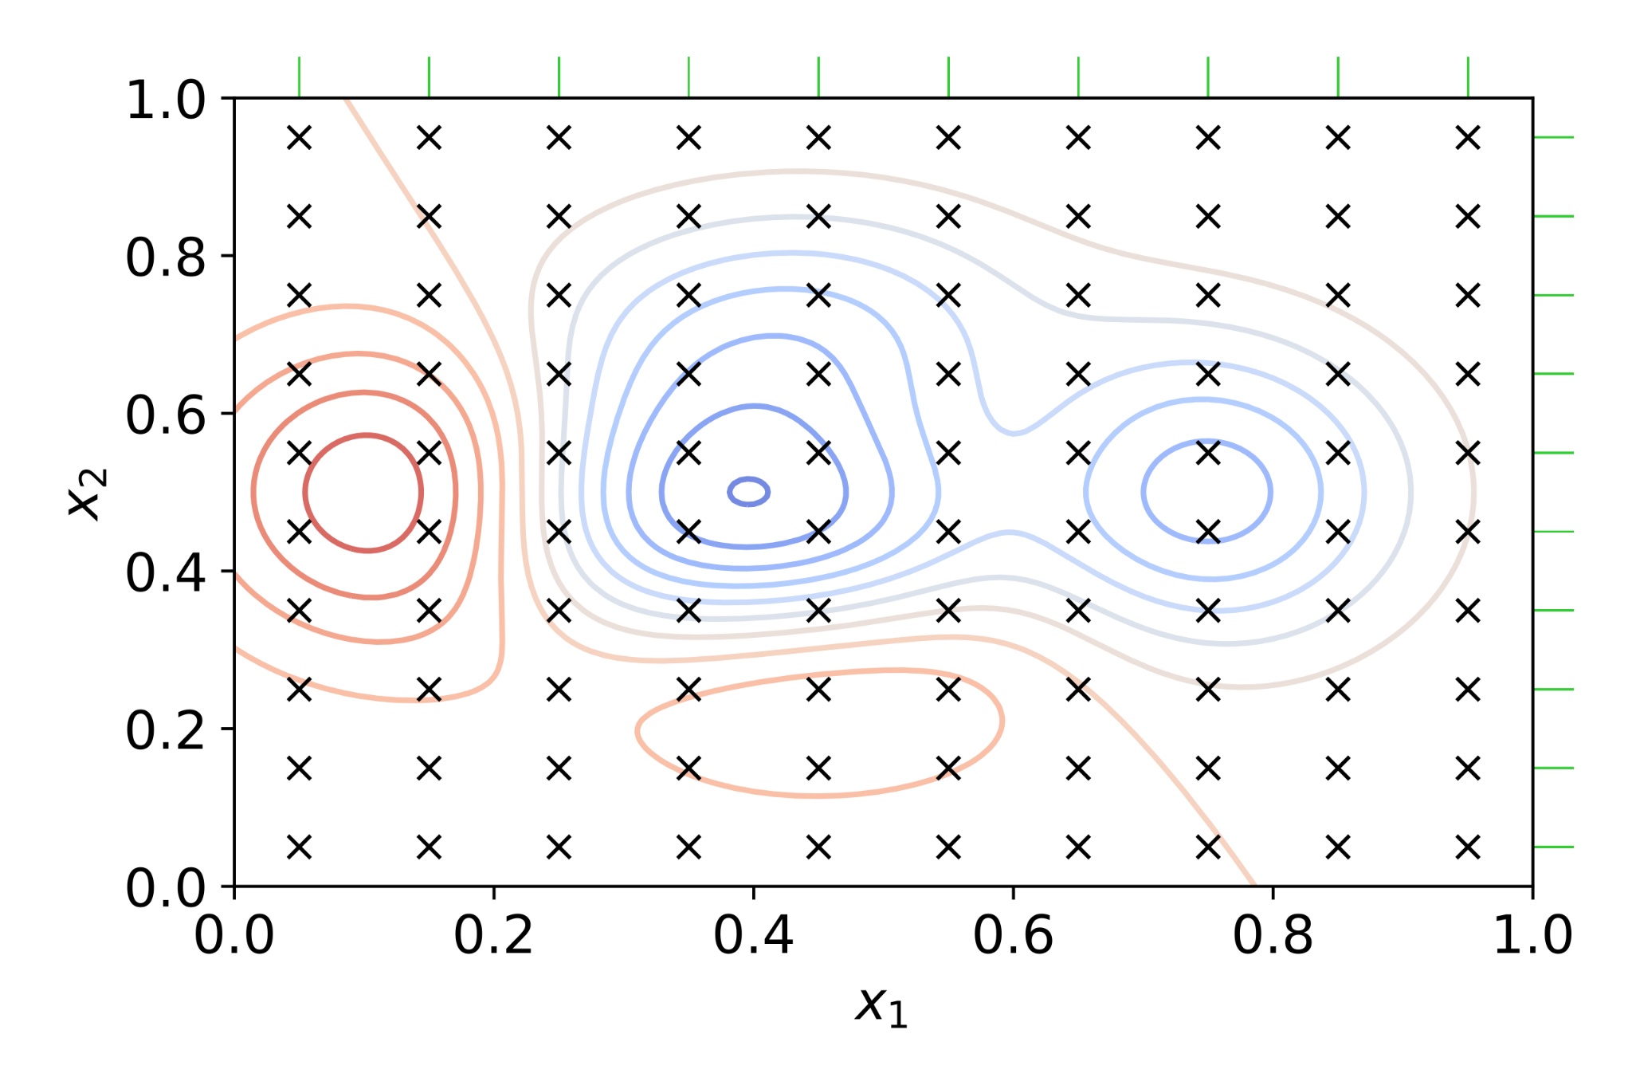
Hyper Parameter Tuning
Rudimentary Grid Search
Simplistic method, systematic guess and check
Tested Alpha values from [0, 1]
Tested Mixing Parameter from [0, .9]

Slide 11
Results
All three models converged to similar results, certain features were closer than others
Coordinate Descent had better error than Gradient Descent by ~10%
All models had an error of ~$28000
Coordinate Descent, Sklearn, and Gradient Descent
Optimal hyperparameters found via grid search
Optimal Alpha: 0.23076923076923075
Optimal Mixing Ratio: 0.8769230769230769
Model was biased towards Lasso Regression

Slide 12
References
https://pmc.ncbi.nlm.nih.gov/articles/PMC2929880/
https://scikit-learn.org/dev/modules/generated/sklearn.linear_model.ElasticNet.html

